Slide 1


Intensive Course Biology for Technology Department of Agricultural Technology Faculty of Technology, University of Colombo by Dr. Aruna Kumara Udawasala

Slide 2
Classification of Life

Slide 3
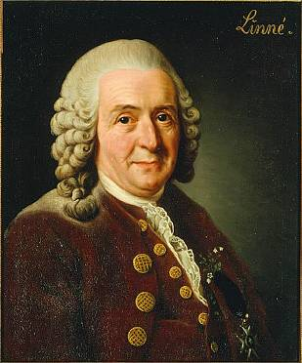
Taxonomy
Organizing, classifying and naming living things
Formal system originated by Carl von Linné (1701-1778)
Identifying and classifying organisms according to specific criteria
Each organism placed into a classification system

Slide 4
Taxonomy
Domain
Kingdom
Phylum
Class
Order
Family
Genus
Species

Slide 5
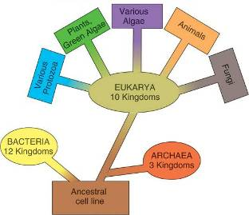
3 Domains
Eubacteria
true bacteria, peptidoglycan
Archaea
odd bacteria that live in extreme environments, high salt, heat, etc. (usually called extremophiles)
Eukarya
have a nucleus & organelles (Protozoa, Fungi, Animals, Plants)

Slide 6
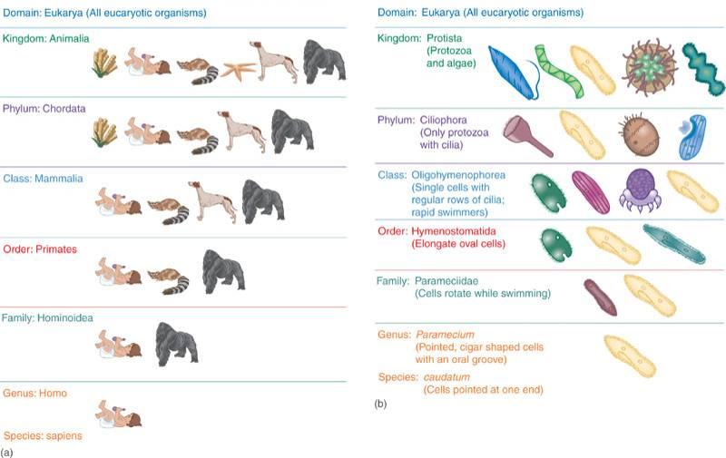

Slide 7
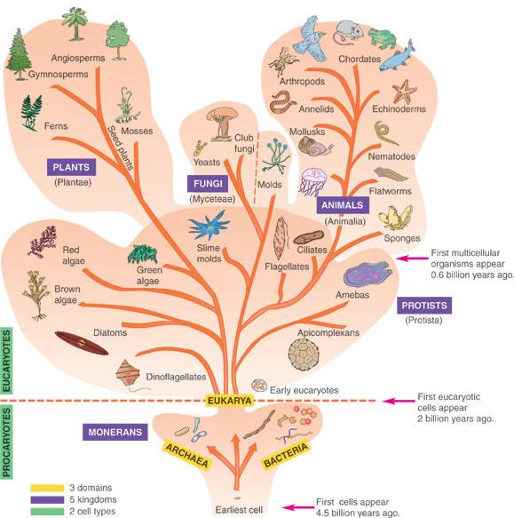

Slide 8
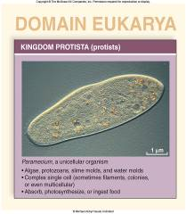
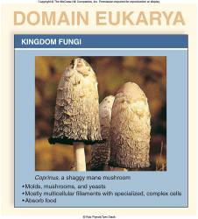
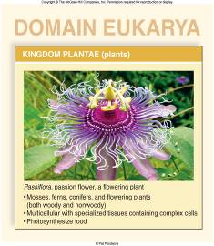
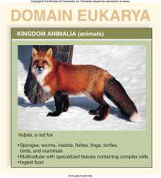
Taxonomy
4 main kingdoms:
Protista
Fungi
Plantae
Animalia

Slide 9
Naming Micoorganisms
Binomial (scientific) nomenclature
Gives each microbe 2 names:
Genus - noun, always capitalized
species - adjective, lowercase
Both italicized or underlined
Staphylococcus aureus (S. aureus)
Bacillus subtilis (B. subtilis)
Escherichia coli (E. coli)

Slide 10
Evolution - living things change gradually over millions of years
Changes favoring survival are retained and less beneficial changes are lost
All new species originate from preexisting species
Closely related organism have similar features because they evolved from common ancestral forms
Evolution usually progresses toward greater complexity

Slide 11
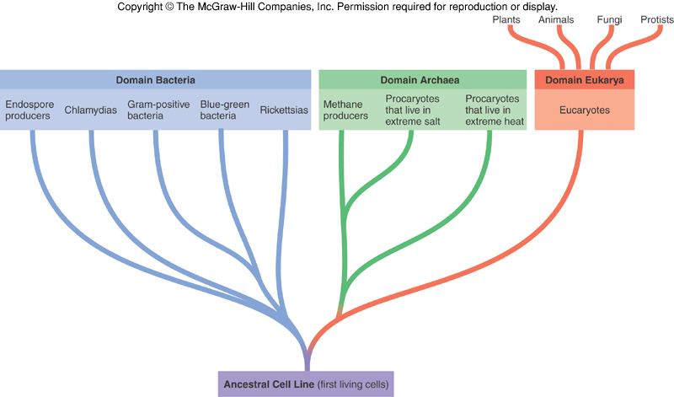
Insert figure 1.15
Woese-Fox System

Slide 12
Classification Systems in the Procaryotae

Slide 13
Classification Systems in the Procaryotae
Microscopic morphology
Macroscopic morphology – colony appearance
Physiological / biochemical characteristics
Chemical analysis
Serological analysis
Genetic and molecular analysis
G + C base composition
DNA analysis using genetic probes
Nucleic acid sequencing and rRNA analysis

Slide 14
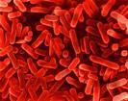
Bacterial Taxonomy Based on Bergey’s Manual
Bergey’s Manual of Determinative Bacteriology – five volume resource covering all known procaryotes
classification based on genetic information –phylogenetic
two domains: Archaea and Bacteria
five major subgroups with 25 different phyla

Slide 15
Major Taxonomic Groups of Bacteria
Domain Archaea
primitive, adapted to extreme habitats and modes of nutrition
Domain Bacteria
Phylum Proteobacteria – Gram-negative cell walls
Phylum Firmicutes – mainly Gram-positive with low G + C content
Phylum Actinobacteria – Gram-positive with high G + C content

Slide 16
Diagnostic Scheme for Medical Use
Uses phenotypic qualities in identification
restricted to bacterial disease agents
divides based on cell wall structure, shape, arrangement, and physiological traits

Slide 17
Species and Subspecies
Species
collection of bacterial cells which share an overall similar pattern of traits in contrast to other bacteria whose pattern differs significantly
Strain or variety
culture derived from a single parent that differs in structure or metabolism from other cultures of that species (biovars, morphovars)
Type
subspecies that can show differences in antigenic makeup (serotype or serovar), susceptibility to bacterial viruses (phage type) and in pathogenicity (pathotype)

Slide 18
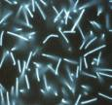
Archaea: The Other Procaryotes
Constitute third Domain Archaea
Seem more closely related to Domain Eukarya than to bacteria
Contain unique genetic sequences in their rRNA
Have unique membrane lipids and cell wall construction
Live in the most extreme habitats in nature, extremophiles
Adapted to heat, salt, acid pH, pressure and atmosphere
Includes: methane producers, hyperthermophiles, extreme halophiles, and sulfur reducers

Slide 19
Eukaryotes

Slide 20
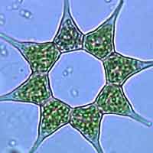
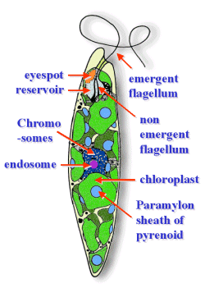
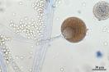
Eukaryotes
Protista
Fungi
Plantae
Animalia

Slide 21
Protista Classification

Slide 22
Fungal Classification
Sexual reproduction
Spores are formed following fusion of male and female strains and formation of sexual structure
Sexual spores and spore-forming structures are one basis for classification
Zygospores
Ascospores
Basidiospores

Slide 23
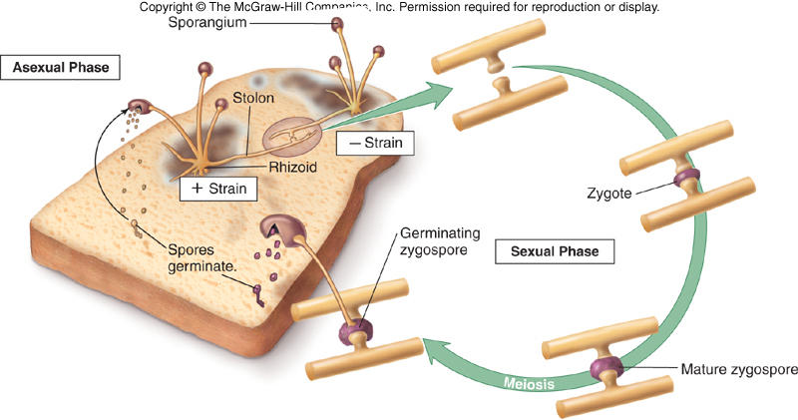

Slide 24
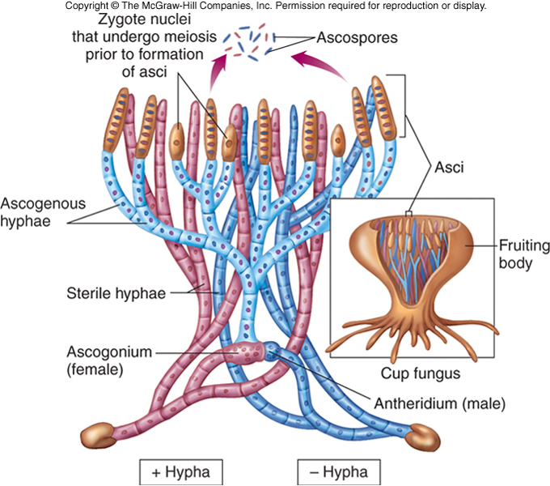

Slide 25
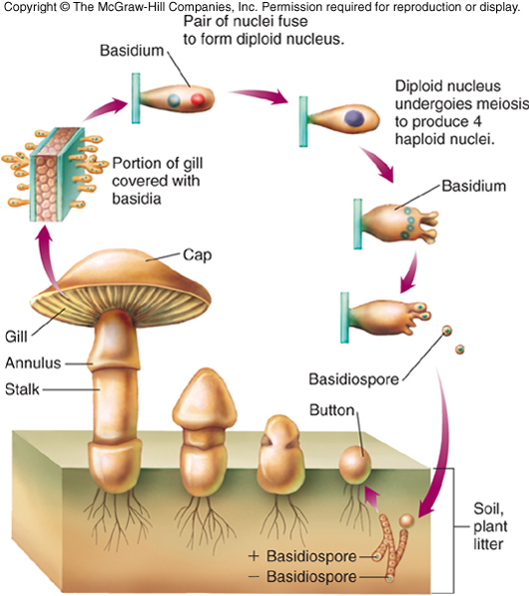

Slide 26
Fungal Classification
Subkingdom Amastigomycota
Terrestrial inhabitants including those of medical importance:
Zygomycota – zygospores; sporangiospores and some conidia
Ascomycota – ascospores; conidia
Basidiomycota – basidiospores; conidia
Deuteromycota – majority are yeasts and molds; no sexual spores known; conidia

Slide 27
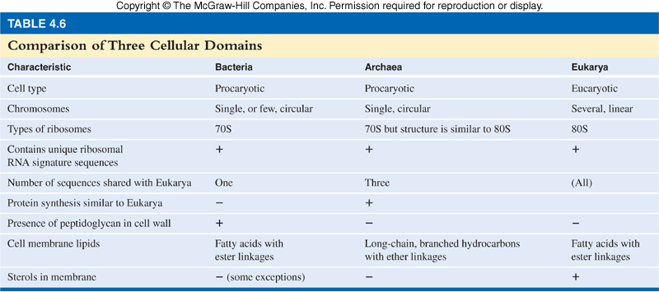

Slide 28
Plantae

Slide 29
Animalia

